Slide 1
Internship on machine learning with python
KARUNADU TECHNOLOGIES PRIVATE LTD.
Presented by:
Shanmukha Shivu AU
Kalpataru Institute Of Technology ,Tiptur
Under the Guidance of:
Mr. Sunil

Slide 2

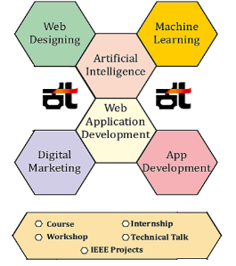
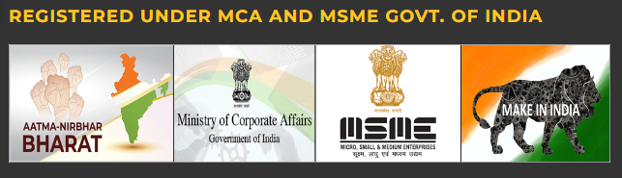
Company Profile
KARUNADU TECHNOLOGIES PRIVATE LTD.
Karunadu Technologies Pvt. Ltd. Is a leading IT software solutions and services industry focusing on quality standards and customer values. It offer broad range of customized software applications powered by concrete technology and industry expertise .Karunadu Technologies Pvt. Ltd. It deal with broad range of product development along with customized features ensuring at most customer satisfaction .
CONTACT DETAILS
Phn no.- +91-9902913646 Email ID -upport@karunadutechnologies.com
Address - #17,ATK complex,2nd Floor,
Acharya College Main Road,
Guttebasaveshwaranagar Chikkabanvara,
Bengaluru Karnataka 560090
www.karunadutechnologies.com

Slide 3





Internship outcome
Basics of Python
Opensource Libraries
Like pandas, numpy, matploit, sklearn etc..
Working with pyqt5
Improvised UI design with desiner.exe
Machine Learning Algorithms
Linear Regression, Multiple Linear Regression, Logistic Regression, KNN, SVM, Decision Tree etc.
Open CV
.

Slide 4
List of Projects
​
Predict of car price using
Multiple Linear Regression
​
Predict fracture or not using SVM
​
Loan prediction using
KNN
​
Predict Hired Or Not using LOGISTIC

Slide 5
Project 1:
Predict Car Price using Multiple Linear Regression
Datasets Used:
0 Car_Name 301 non-null object
1 Year 301 non-null int64
2 Selling_Price 301 non-null float64
3 Present_Price 301 non-null float64
4 Kms_Driven 301 non-null int64
5 Fuel_Type 301 non-null object
6 Seller_Type 301 non-null object
7 Transmission 301 non-null object
8 Owner 301 non-null int64

Slide 6
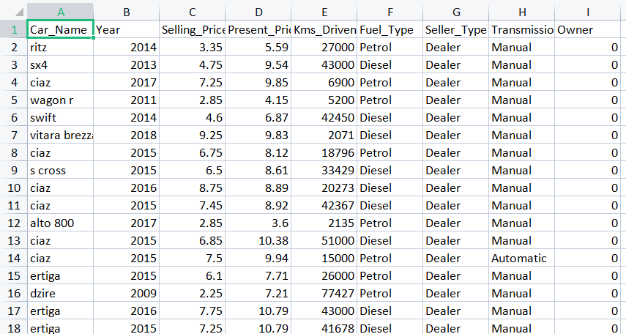
Inputs and outputs :
in years)

Slide 7
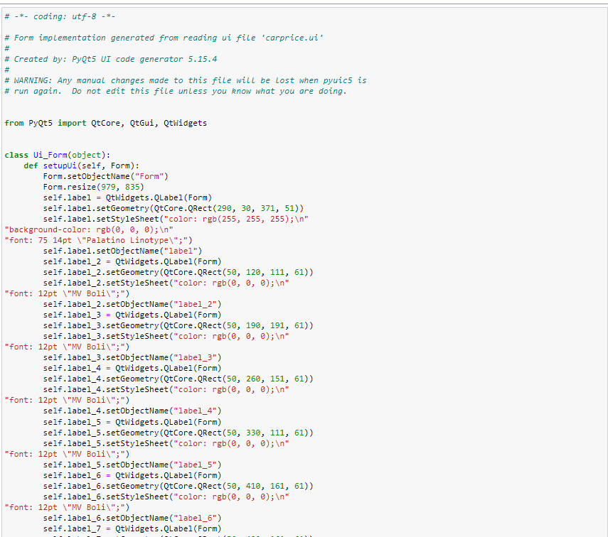
Code Snapshots
‹#›
Internship on ML
KIT

Slide 8
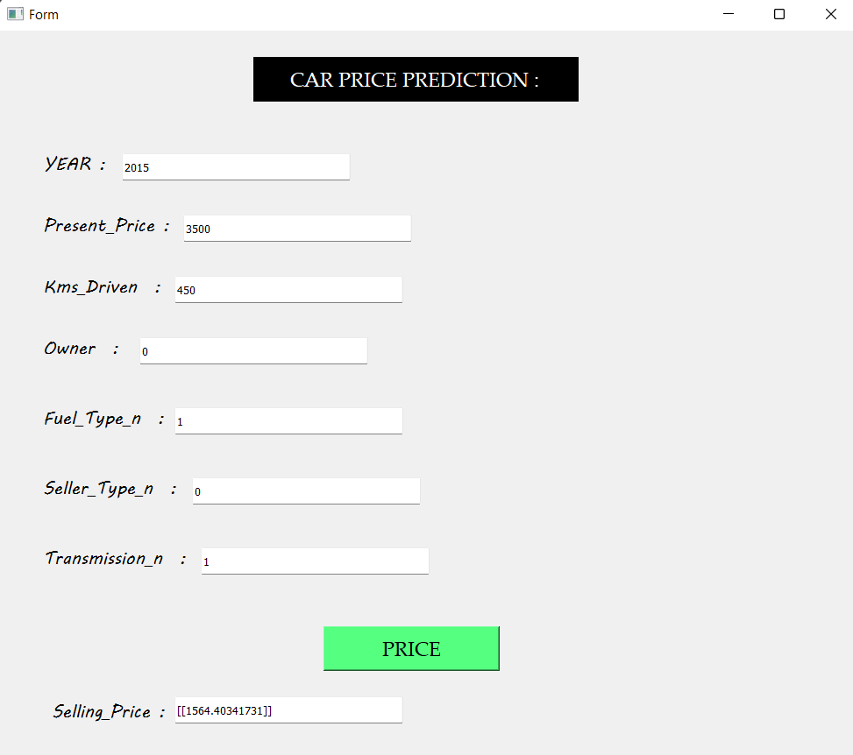
Result Snapshot
‹#›
Internship on ML
SDMIT

Slide 9
Conclusion
This Internship has been an excellent and rewarding experience for me. I can conclude that there have been lot I’ve learnt in this internship, the internship gave a board spectrum of knowledge in the domain of python with machine learning.
The two main thing I have learned after my experience in this internship are the importance of time management and being self motivated

Slide 10
Project 2:
Predict Fracture using SVM
Datasets Used:
id – patient’s number
age – patient’s age
fracture – hip fracture (fracture / no fracture)
weight_kg – weight measured in Kg
height_cm – height measure in cm
waiting_time – time the patient had to wait for the densitometry (in minutes)
bmd – bone mineral density measure in the hip

Slide 11
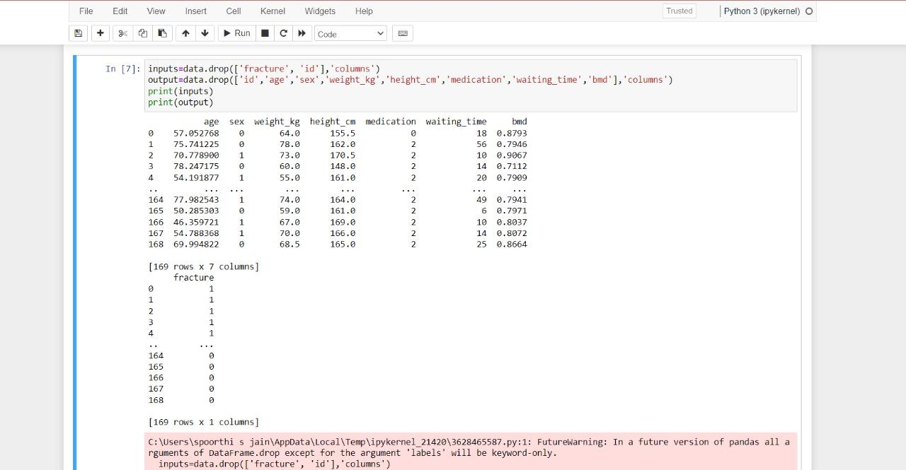
Inputs and outputs :
in years)

Slide 12
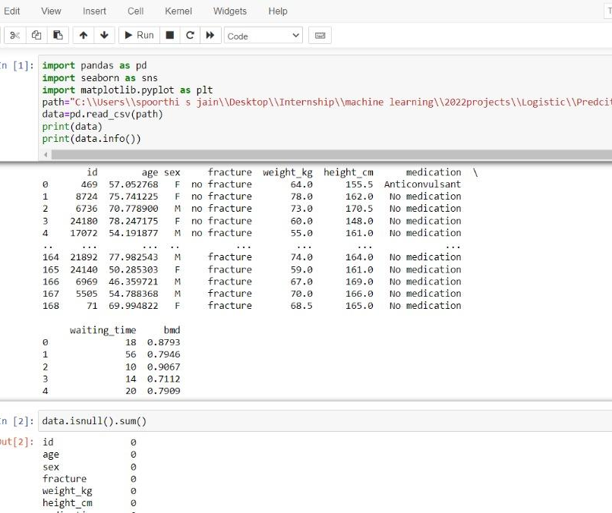
Code Snapshots
‹#›
Internship on ML
KIT

Slide 13
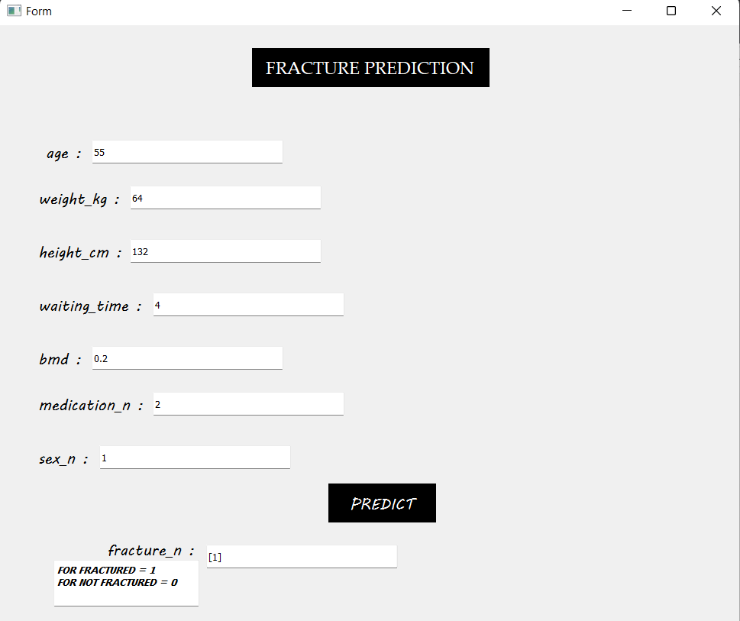
Result Snapshot
‹#›
Internship on ML
SDMIT

Slide 14
Conclusion
This Internship has been an excellent and rewarding experience for me. I can conclude that there have been lot I’ve learnt in this internship, the internship gave a board spectrum of knowledge in the domain of python with machine learning.
The two main thing I have learned after my experience in this internship are the importance of time management and being self motivated

Slide 15
Project 3:
Predict Loan using KNN
Datasets Used:
1 Gender 601 non-null object
2 Married 611 non-null object
3 Dependents 599 non-null object
4 Education 614 non-null object
5 Self_Employed 582 non-null object
6 ApplicantIncome 614 non-null int64
7 CoapplicantIncome 614 non-null float64
8 LoanAmount 592 non-null float64
9 Loan_Amount_Term 600 non-null float64
10 Credit_History 564 non-null float64
11 Property_Area 614 non-null object
12 Loan_Status 614 non-null object

Slide 16
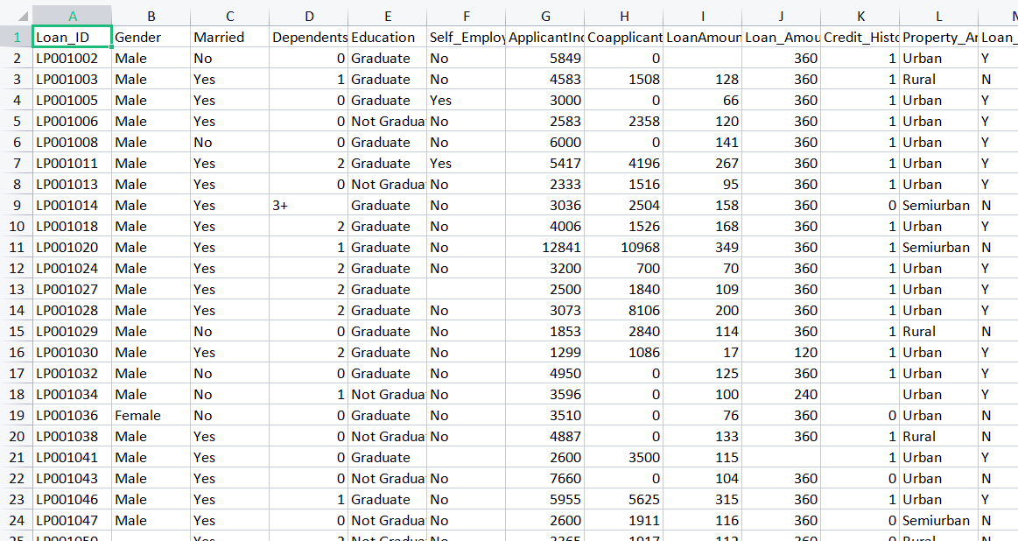
Inputs and outputs :
in years)

Slide 17
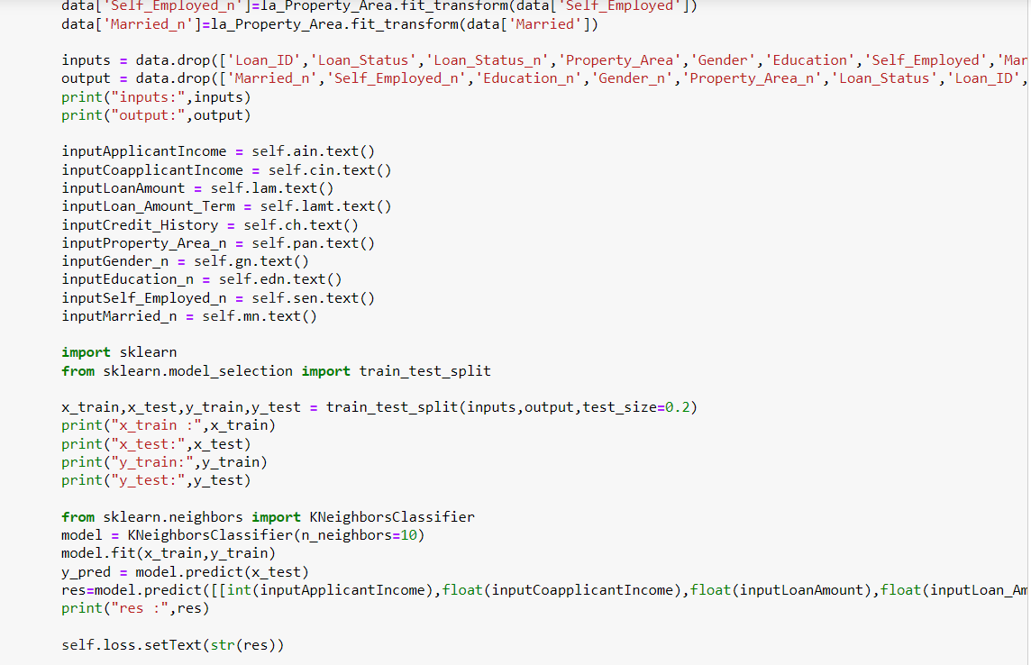
Code Snapshots
‹#›
Internship on ML
KIT

Slide 18
Result Snapshot
‹#›
Internship on ML
SDMIT

Slide 19
Conclusion
This Internship has been an excellent and rewarding experience for me. I can conclude that there have been lot I’ve learnt in this internship, the internship gave a board spectrum of knowledge in the domain of python with machine learning.
The two main thing I have learned after my experience in this internship are the importance of time management and being self motivated

Slide 20
Project 4:
Predict Hire Or Not using Logistic
Datasets Used:
0 Status 30 non-null int64
1 Interview 30 non-null int64
2 CGPA 30 non-null int64
3 Written 30 non-null int64
4 Aptitude 30 non-null int64

Slide 21
Inputs and outputs :
in years)

Slide 22
Code Snapshots
‹#›
Internship on ML
KIT

Slide 23
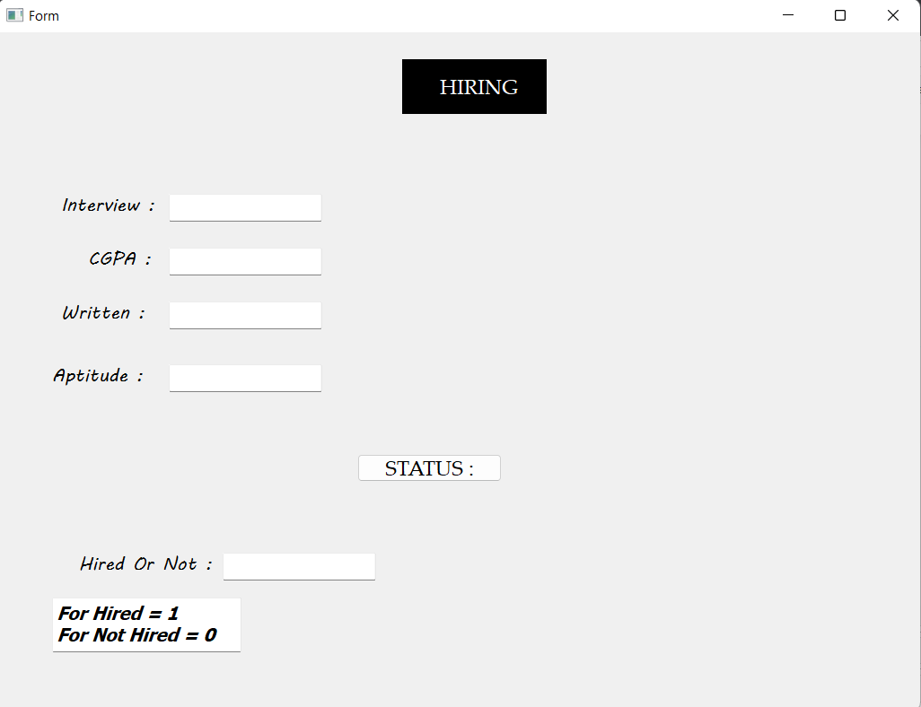
Result Snapshot
‹#›
Internship on ML
SDMIT

Slide 24
Conclusion
This Internship has been an excellent and rewarding experience for me. I can conclude that there have been lot I’ve learnt in this internship, the internship gave a board spectrum of knowledge in the domain of python with machine learning.
The two main thing I have learned after my experience in this internship are the importance of time management and being self motivated

Slide 25
Thank you
Shanmukha Shivu AU
At Karunadu Technologies private LTD
7th sem CSE, Kalpataru Institiute Of Technology , Tiptur

